Slide 1
Feature Engineering on
Healthcare Patient Records
A Project on Data Cleaning, Modeling, and Heart Disease Prediction
Presented by - Amreen Haque Ansari

Slide 2

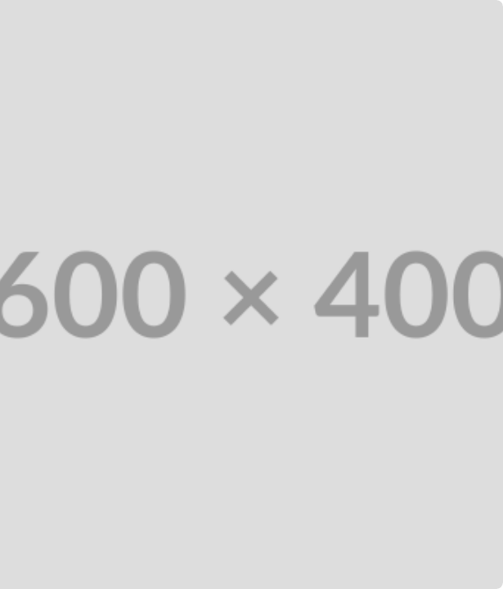
Project Objectives
✓
Clean and preprocess the sparse UCI Heart Disease dataset.
✓
Engineer a binary target variable ('disease' vs. 'no disease') from multi-class data.
✓
Build and evaluate two predictive models for heart disease.
✓
Compare the performance of Logistic Regression and a tuned Random Forest.

Slide 3
The Raw Dataset: A Key Challenge
The dataset contained 920 patient records, but analysis revealed significant data sparsity. Columns critical for prediction were missing over 50% of their data, making imputation essential.
Feature | Missing Count | % Missing
ca | 611 | 66.4%
thal | 486 | 52.8%
slope | 309 | 33.6%
fbs | 90 | 9.8%

Slide 4






Data Cleaning & Preprocessing
1. Handle Invalid Zeros
2. Imputation
3. Encoding
Replaced '0' values in 'trestbps', 'chol', and 'thalch' with NaN, as a value of 0 is clinically impossible for these features.
Filled numeric NaN values (like 'ca') with the **median** and categorical NaN values (like 'thal') with the **mode**.
Converted all object-type features (e.g., 'sex', 'cp') into numerical values using `LabelEncoder` to prepare them for the models.

Slide 5
Feature Engineering: Creating a Binary Target
The original 'num' column (0-4) represented the *degree* of disease. For this classification task, a new binary 'target' was engineered.
0
1
No Disease (num == 0)
Disease Present (num > 0)

Slide 6
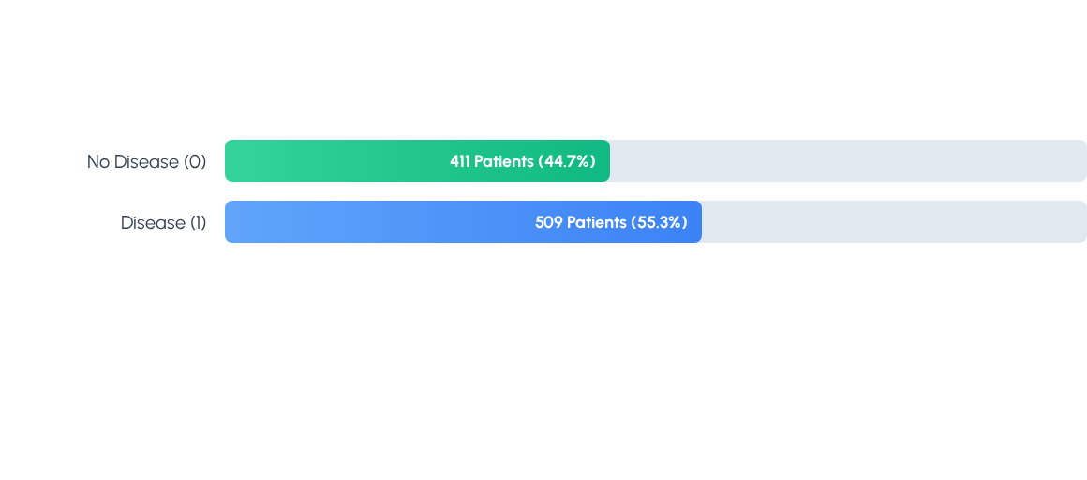
Exploratory Data Analysis: Target Distribution
After engineering, the dataset shows a relatively balanced, though slightly larger, number of patients with heart disease (509) versus no disease (411).

Slide 7
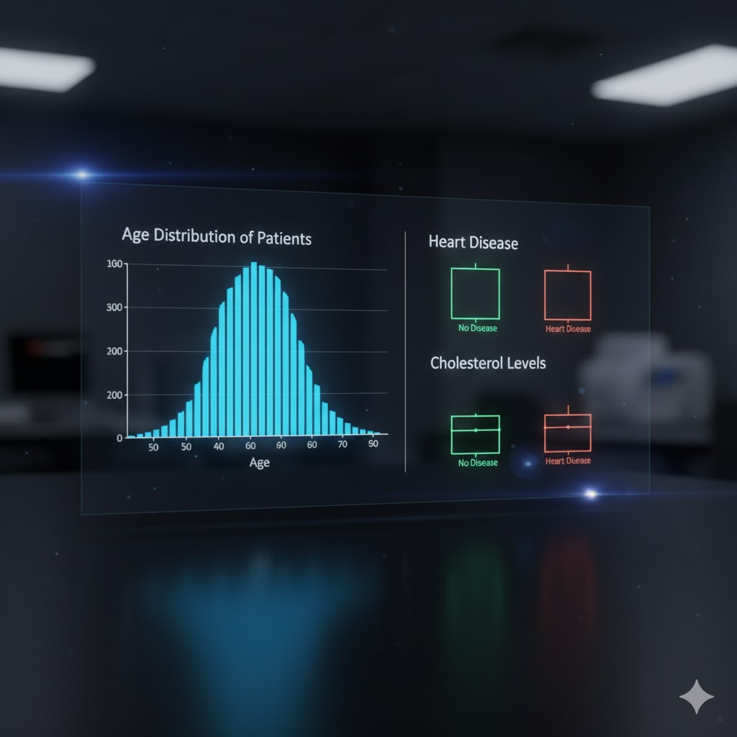
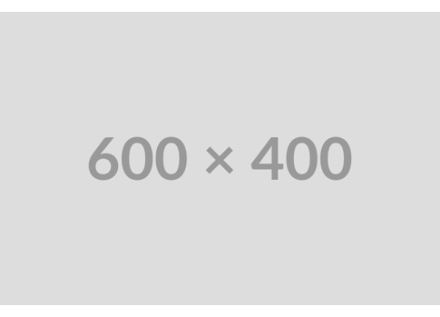
EDA: Age and Cholesterol Analysis
Exploratory Data Analysis (EDA) provided key insights into the patient data. The boxplots from the notebook revealed clear trends:
→
Age: Patients with heart disease (Target 1) had a higher median age compared to those without the disease.
→
Cholesterol: Similarly, patients with heart disease also showed slightly higher median cholesterol levels.
These findings confirm that age and cholesterol are important factors in predicting heart disease.

Slide 8


EDA: Feature Correlation Heatmap
A heatmap was generated to visualize the relationships between all features. This helped identify which factors were most strongly correlated with the 'target' variable, guiding the feature selection and modeling process.

Slide 9


Model Preparation
1. Train-Test Split
2. Feature Scaling
The cleaned data was split into an 80% training set (for teaching the models) and a 20% testing set (for evaluation). The split was stratified to ensure both sets had the same ratio of 'disease' to 'no disease' cases.
StandardScaler was applied to all features. This process normalizes the data, giving each feature a mean of 0 and a standard deviation of 1. This is crucial for models like Logistic Regression to perform accurately and fairly.

Slide 10
Model 1: Logistic Regression Results
A baseline Logistic Regression model was trained on the scaled data. It achieved a strong initial accuracy.
Test Accuracy: 79.3%
Confusion Matrix:
 | Predicted No Disease (0) | Predicted Disease (1)
Actual No Disease (0) | 60 (True Negative) | 22 (False Positive)
Actual Disease (1) | 16 (False Negative) | 86 (True Positive)

Slide 11

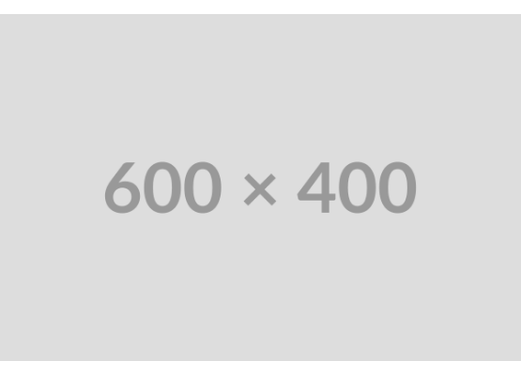
Model 2: Random Forest Tuning
To build a more complex model, a Random Forest was tuned using GridSearchCV. This tested 108 parameter combinations to find the best-performing model.
Best Parameters Found:
→
n_estimators: 200
→
max_depth: 10
→
min_samples_leaf: 2
→
min_samples_split: 5
Best Cross-Validation Accuracy: 81.0%

Slide 12
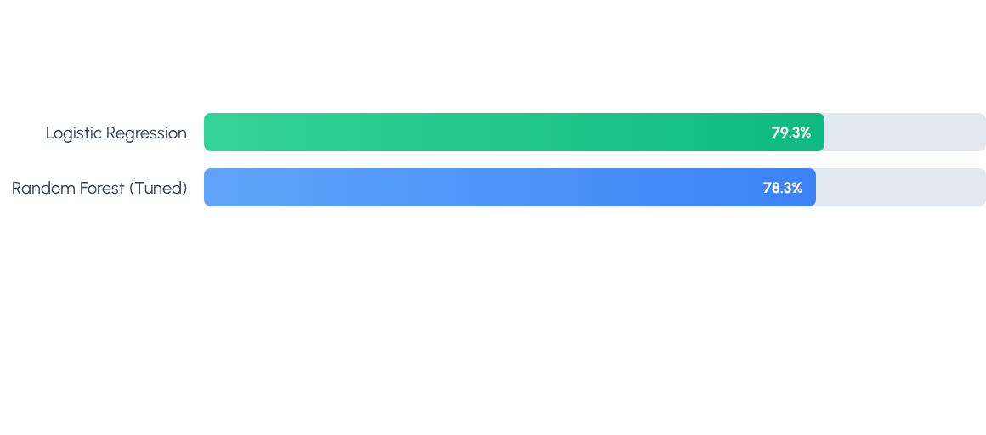
Model Comparison & Conclusion
Both models performed well. The simpler Logistic Regression slightly outperformed the tuned Random Forest on the final test set. This demonstrates the power of clean data and solid feature engineering, which made the linear relationships clear enough for the simpler model to capture effectively.

Slide 13
THANK YOU

